Slide 1
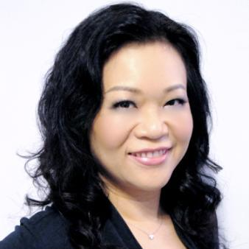
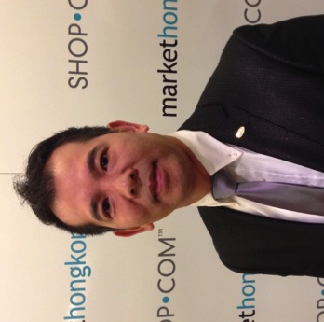
TLS®搌展無限商機
TLS® Business Development
May Lun
資深主管經理級 Senior Master Coordinator
四個佣金週期共賺取HK$23,000
HK$23,000 in 4 Commission weeks
Rayon Lam
經理級 Executive Coordinator
四個佣金週期共賺取HK$11,500
HK$11,500 in 4 Commission weeks
本簡報中提到的收入等級純屬舉例說明，無意代表美安香港經銷商的一般收入，也無意表示任何經銷商皆可賺取同等收入。美安香港經銷商的成功與否，取決於其在發展事業時的努力、才能與投入程度。The income levels mentioned in the following presentation are for illustration purposes only. They are not intended to represent the income of a typical Market Hong Kong Distributor, nor are they intended to represent that any given Independent Distributor will earn income in that amount. The success of any Market Hong Kong Independent Distributor will depend upon the amount of hard work, talent, and dedication which he or she devotes to building his or her Market Hong Kong Business.

Slide 3
你為甚麼在這裡？ WHY ARE YOU HERE?
你覺得自己需要減去多少體重？
你以前試過甚麼減重方法？
有成功過嗎？
甚麼驅使你減重？
How much weight do you think you need to lose?
What types of programs have you tried in the past?
Did you have success with those programs?
What’s your motivation to lose weight?

Slide 4
為甚麼你無法成功減重？ WHY YOU STRUGGLE WITH YOUR WEIGHT?
進食份量
Portion Size
搖搖式飲食
Yo-yo Dieting
壓力
Stress
加工食物
Processing Food
缺乏活動Sedentary Lifestyles

Slide 5
TLS®健康生活纖營計劃
TLS® Weight Loss Solution
增加活動及運動量：
跳舞、保齡球、走路、
單車、行樓梯
健康飲食：
低升糖指數飲食、
蛋白質、蔬菜、
水果、纖維 、
健康脂肪、水
Increase Activity Level:
Dancing, Bowling, Walking,
Cycling and Walking up
Stairs
20%
Health Eating:
Low GI Diet, Protein,
Vegetable, Fruit,
Fiber, Healthy Fat,
Water
50%
行為修正：
養成健康習慣、
生活日誌、營養補充品、
教學支援系列DVD、
教練的責任
30%
健康飲食
Health Eating
行為修正
Behavioral Modification
運動
Exercise/Being Active
Behavioral Modification:
Learning good habits, Journaling,
Supplements, Educational DVD Series,
Coaching
L

Slide 6
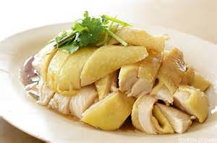
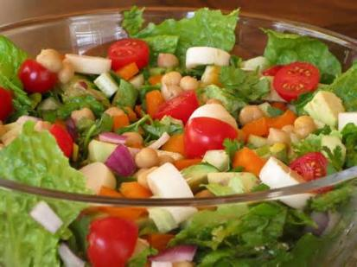
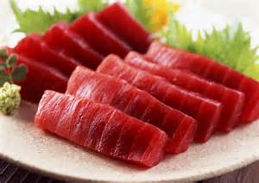
甚麼是TLS®健康生活纖營計劃？
What is TLS® Weight Loss Solution?
低升糖飲食
有助減重及體重管理
維持瘦肌肉量
心血管健康
Low Glycemic Impact Eating
Superior for weight loss and weight management
Maintaining lean muscle mass
Cardiovascular health

Slide 7
甚麼是TLS®健康生活纖營計劃？
What is TLS® Weight Loss Solution?
身體構成
修復及提升新陳代謝
運動
Body Composition
Repair and increase metabolism
Exercise

Slide 8
甚麼是TLS®健康生活纖營計劃？
What is TLS® Weight Loss Solution?
加速減重產品／補充品
支援健康新陳代謝
支援健康
Weight Loss Accelerators / Supplements
Support healthy metabolism
Support health

Slide 9
你會學到些甚麼？
What will you learn?
如何不節食！
不用計算卡路里
不用限制卡路里，或避免某一類食物
如何購買健康食物
如何閱讀並了解標籤
為甚麼某些碳水化合物比其他的健康
How NOT to diet!
No calorie counting
No calorie restriction or avoidance of specific food
How to make healthier food choices
How to read food label
Why certain types of carbohydrate are better than other

Slide 10
了解更多有關TLS®計劃 Learn More about TLS® Program…
NMTSS會議聯盟系統：
TLS®概覽
TLS® Day 1訓練
TLS® Day 2訓練
NMTSS:
TLS® Overview Training
TLS® Day 1 Training
TLS® Day 2 Training

Slide 11
TLS®授證教練 Certified Coach
為令你保持在正確方向
此調整吸引更多夥伴以TLS®作為主修及發展其超連鎖™事業
To keep you on the right track
This helps more partners major in TLS® and expand their UnFranchise™ businesses

Slide 12
纖形業務－800億美元市場 Weight Loss Market – USD80 BILLION Industry
纖形行業可分6個類型
食物、代餐及飲品
藥物
醫療
營養補充品
健身、器械及配件
纖形業務
Diet Industry falls into 6 different categories
Food, Substitutes & Beverages
Drug
Clinical
Supplements
Fitness, Devices, and Accessories
Commercial
Notes:
Day 1 Slide – Growth in past 5 Years

Slide 13
纖形業務－800億美元市場 Weight Loss Market – USD80 BILLION Industry
七成人喜歡自己進行纖形而不選擇每星期幾次到纖形中心、診所或醫院參加正規、有系統的纖形計劃。
這些人仍需要及希望得到協助
70% of people prefer to lose weight by themselves rather than joining a formal, structured program that requires several visits per week to a weight loss center, clinic or hospital.
These People Still NEED and WANT Support

Slide 14
TLS®－我們為你的業務提供： We Offer Your Business:
Turn Key System
Weight Loss Coaching
2-3 year business model
Coaches Tools
Business Guide
Health Guide
Find Your Fit Challenges
Training System
TLS® Day 1 & Day 2
Overview
On Going Support
系統化
纖形指導
兩至三年業務模式
導引工具
業務指南
健康指南
FYF纖形比賽
訓練系統
TLS® Day 1 & Day 2訓練
概覽
持續性支援

Slide 15
TLS®使命 Mission Statement
提供一個系統，讓人們透過幫助其他人達到目標，達致纖形、健康和財務目標。
TLS®團隊
People Paying it Forward…
Providing a system to allow people to obtain their
weight loss, health and financial goals by helping
others achieve theirs.
TLS® Team

Slide 16
28% OFF

Slide 17
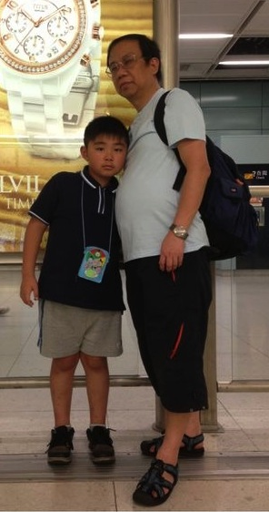
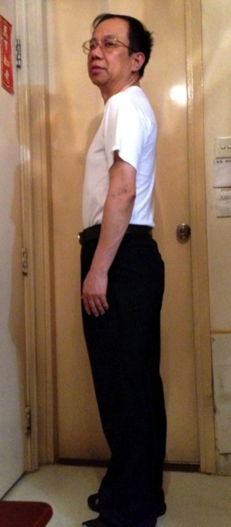
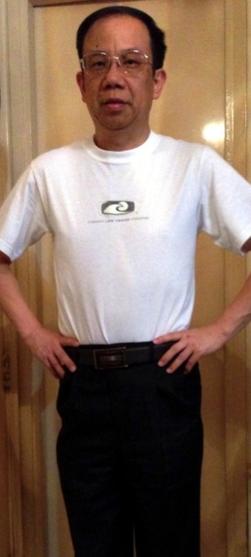
Tony Lam
前 Before
後 After
總體重減少
Total Weight Loss
17 磅 lbs
總脂肪減少
Total Fat Loss
4.6 %
總腰圍減少
Total Waist Loss
5 吋 Inches
*見證人的效果並非典型的，個別人士的效果或有不同。TLS®補充品為 TLS健康生活纖營計劃的一部份，系統包含健康飲食及運動。
*Results shown in this testimonial may not be typical. Individual results will vary. TLS® supplements are part of The TLS Weight Loss Solution which includes a healthy diet and exercise.

Slide 18
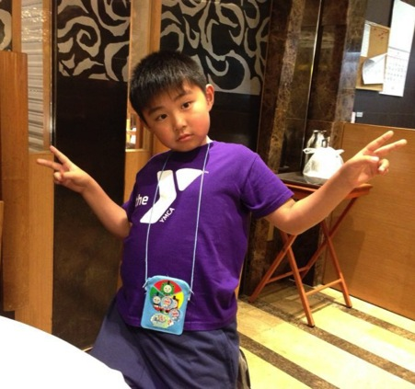
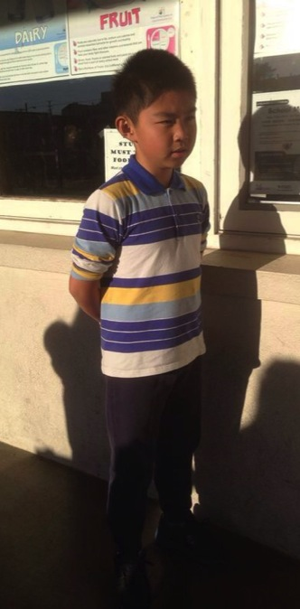
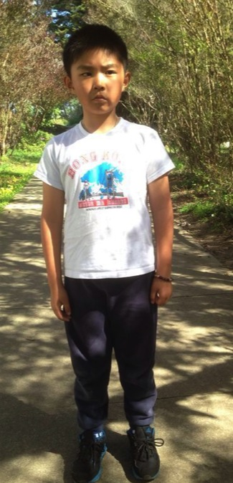
Tony Lam
前 Before
後 After
*見證人的效果並非典型的，個別人士的效果或有不同。TLS®補充品為 TLS健康生活纖營計劃的一部份，系統包含健康飲食及運動。
*Results shown in this testimonial may not be typical. Individual results will vary. TLS® supplements are part of The TLS Weight Loss Solution which includes a healthy diet and exercise.

Slide 19
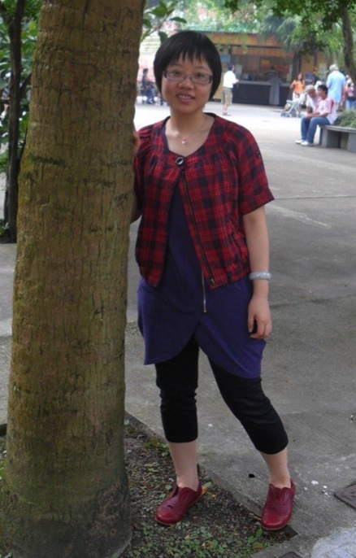
Bonnie Lam
前 Before
後 After
總體重減少
Total Weight Loss
18 磅 lbs
總脂肪減少
Total Fat Loss
5 %
總腰圍減少
Total Waist Loss
5 吋 Inches
*見證人的效果並非典型的，個別人士的效果或有不同。TLS®補充品為 TLS健康生活纖營計劃的一部份，系統包含健康飲食及運動。
*Results shown in this testimonial may not be typical. Individual results will vary. TLS® supplements are part of The TLS Weight Loss Solution which includes a healthy diet and exercise.

Slide 20
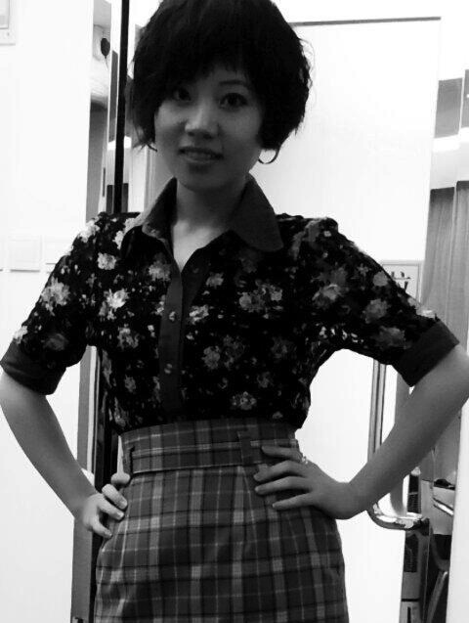
Bonnie Lam
2010年8月
August 2010
2011年11月
November 2011
2012年8月
August 2012
2013年9月
September 2013
*見證人的效果並非典型的，個別人士的效果或有不同。TLS®補充品為 TLS健康生活纖營計劃的一部份，系統包含健康飲食及運動。
*Results shown in this testimonial may not be typical. Individual results will vary. TLS® supplements are part of The TLS Weight Loss Solution which includes a healthy diet and exercise.

Slide 21
FIND YOUR FIT
健康生活纖形比賽
CHALLENGE

